Slide 1
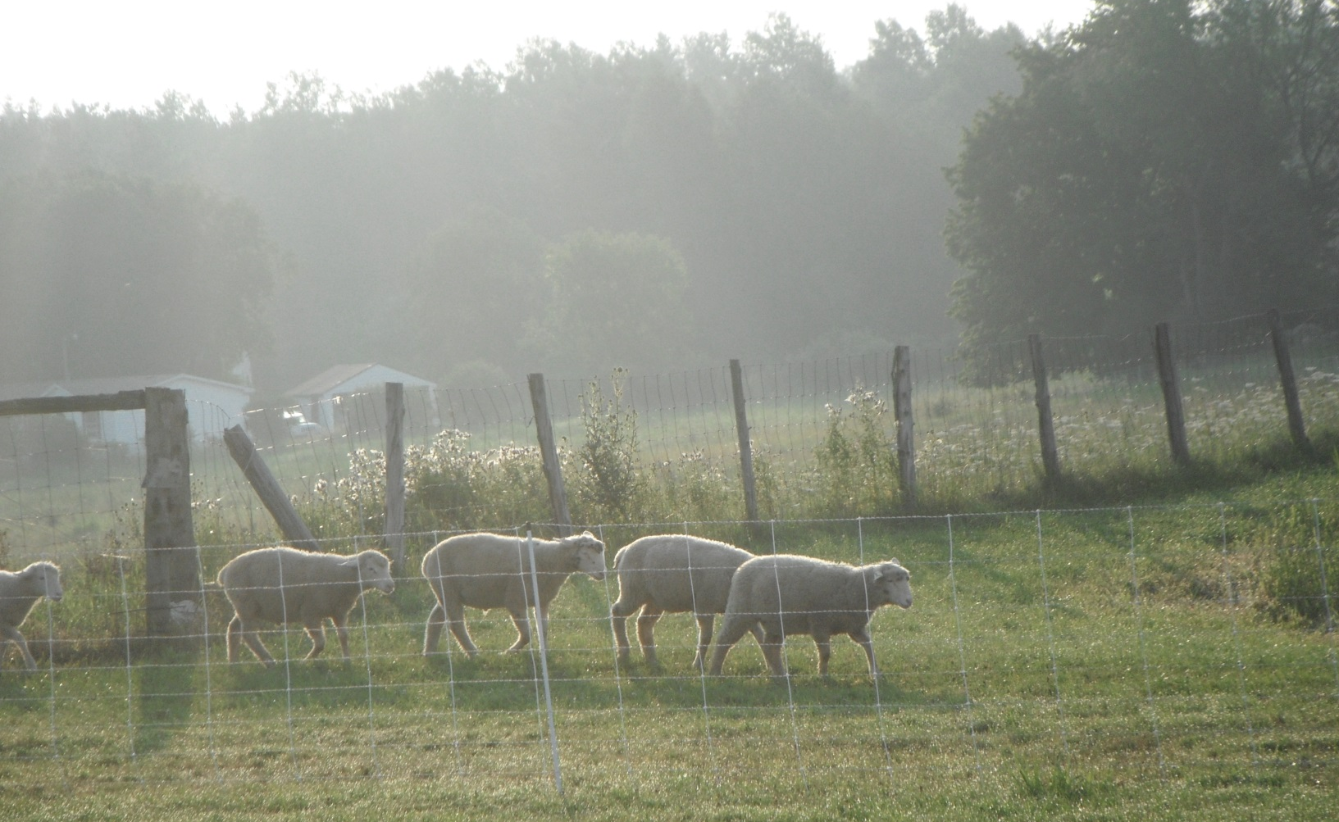
Northern New York Agricultural Development Program (NNYADP) Project:
Internal Parasite Control in Sheep & Goats

Slide 2
St. Lawrence County Extension Learning Farm Canton, NY
Compared grazing a 3 acre field of Pardee Birdsfoot Trefoil (planted in Spring 2014)
To grazing a conventional pasture (renovated in 2014)
Worm counts
FAMACHA Scores
Weight gain
Also compared effect of administering 1 gram of COWP 2 weeks pre-weaning to giving no COWP

Slide 3
St. Lawrence County Extension Learning Farm 3 Acre Field Birdsfoot Trefoil Canton, NY
Soil Type: Muskellunge
Soil pH: 5.9
Buffer pH: 6.0
P: 2 lbs/acre
K: 75 lbs/acre
Ca: 1,932 lbs/acre
Mg: 300 lbs/acre
% OM: 2.9

Slide 4
Soil Preparation and Planting
Plowed in 2013
Disked 2 or 3 times for weed suppression in 2014
Planted with no till seeder June 4th, 2014
Pardee BFT seeded at 7-8 lb per acre with Sunset II Timothy at 4 lb per acre
BFT emerged June 18th
Mowed for weeds Aug 6th, 2014
Fertilized Oct 15th, 2014
Manure spread October 21st, 2014

Slide 5
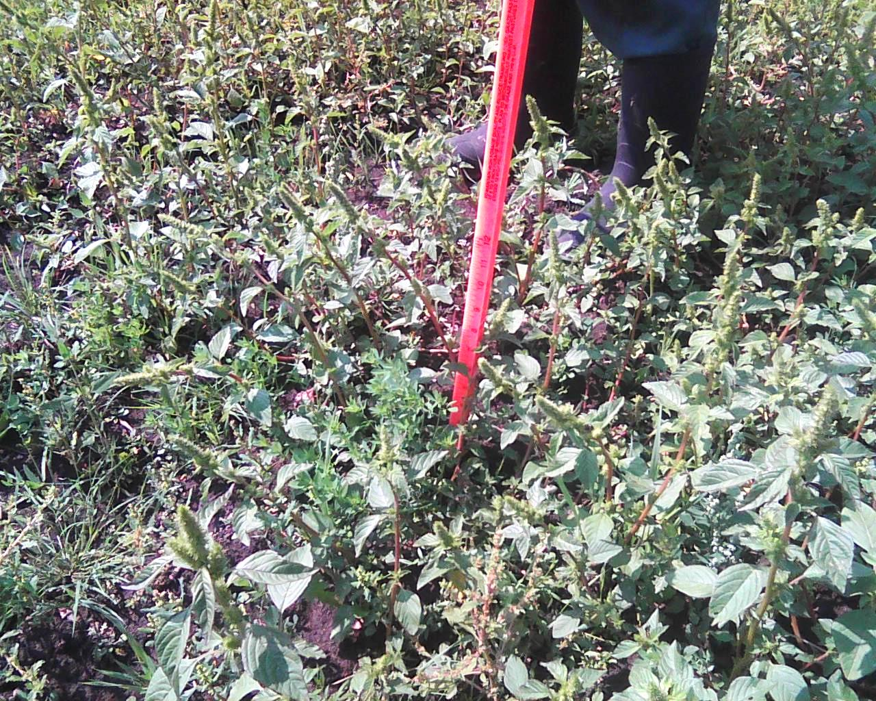
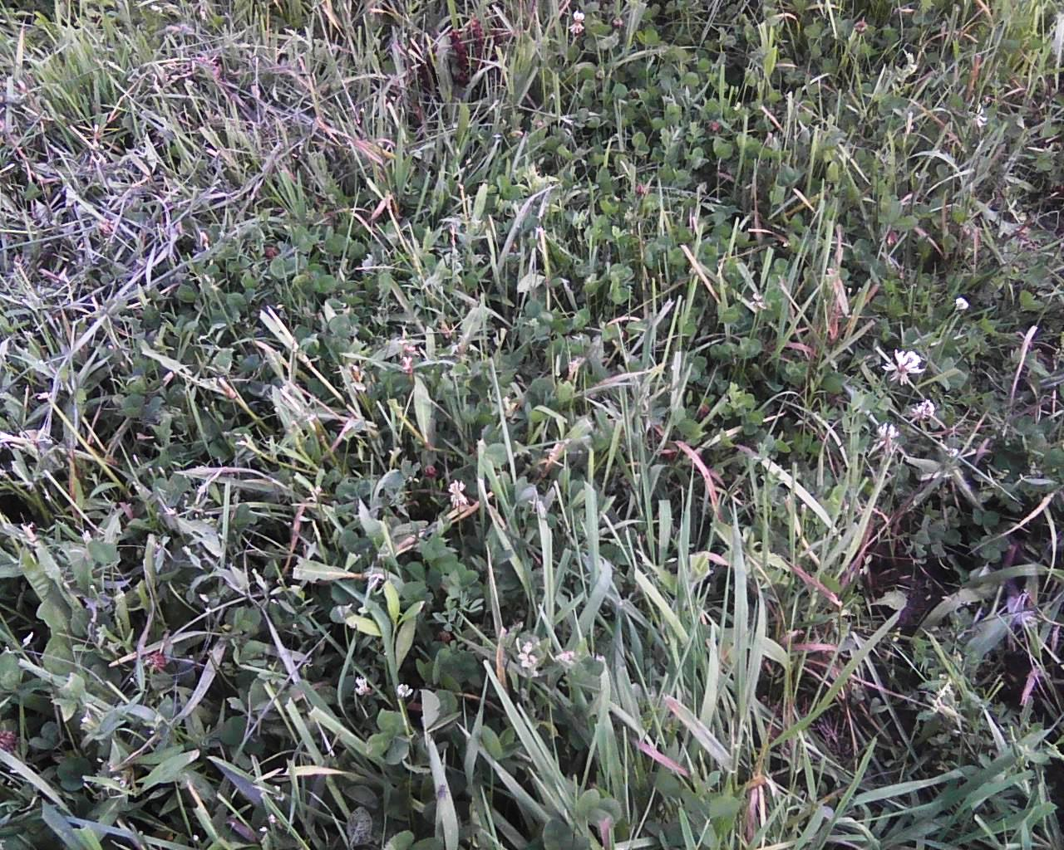
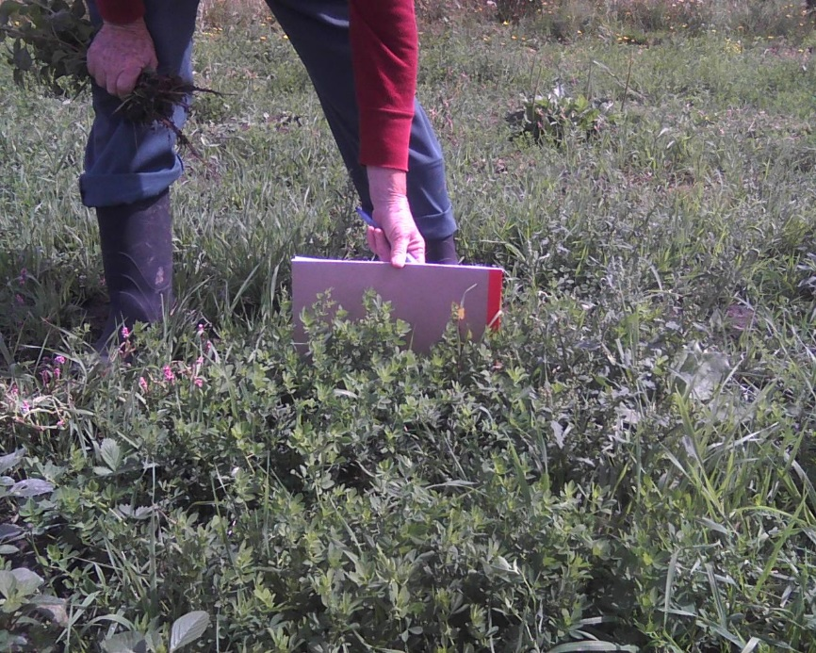
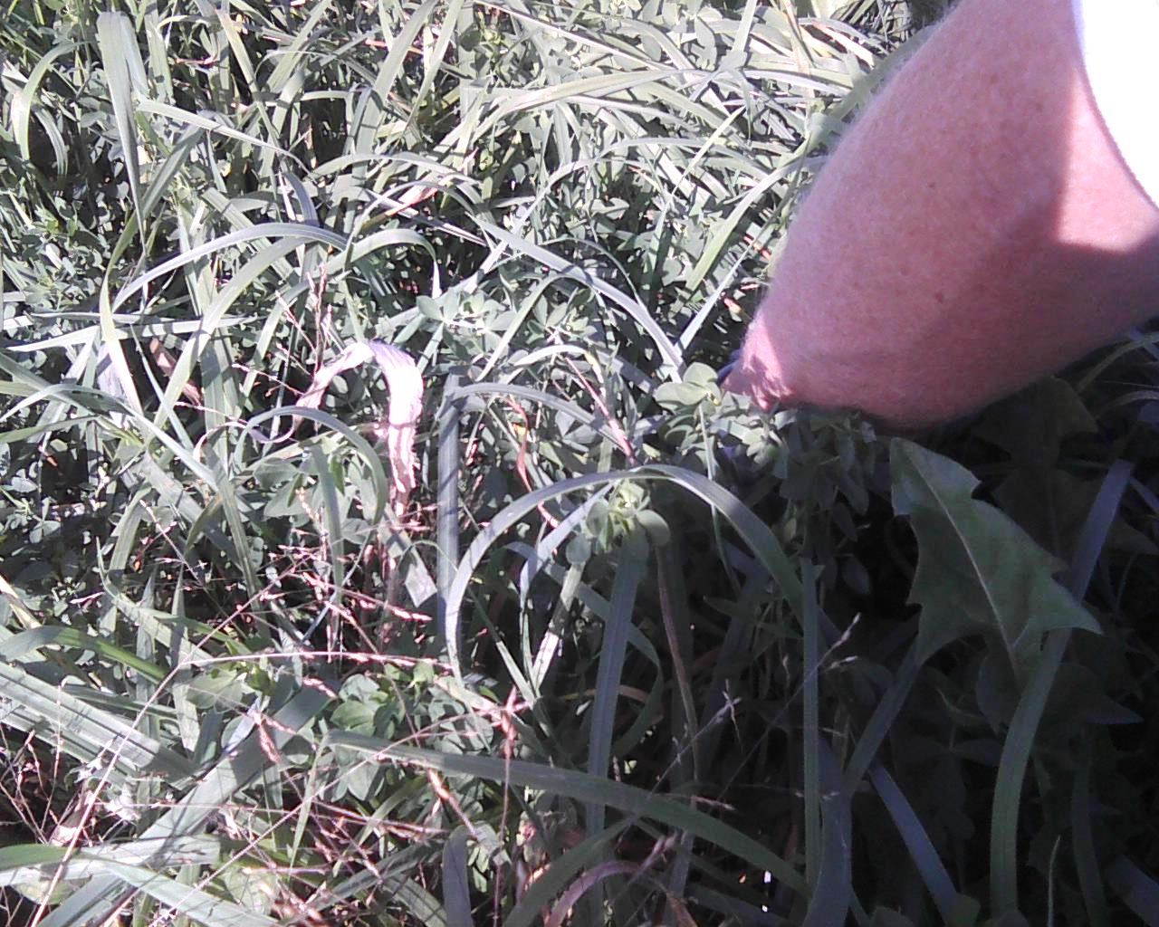

Slide 6
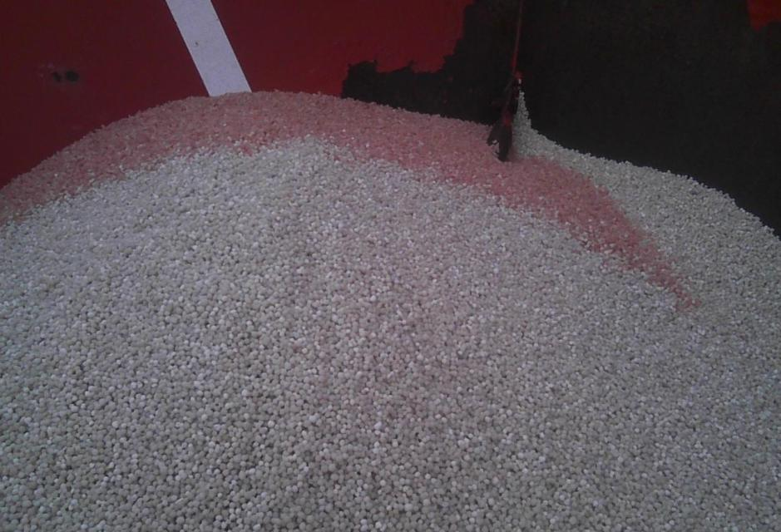
Inorganic plots (1 & 2) got 0-0-60 and 11-52-0 (MAP)

Slide 7
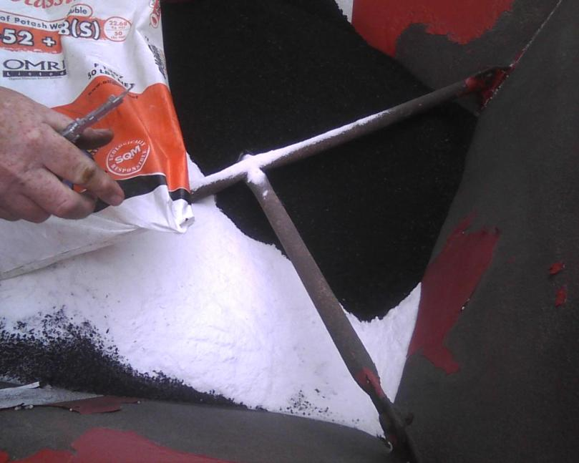
Organic plots (3 & 4) got bone char and sulfur of potash

Slide 8
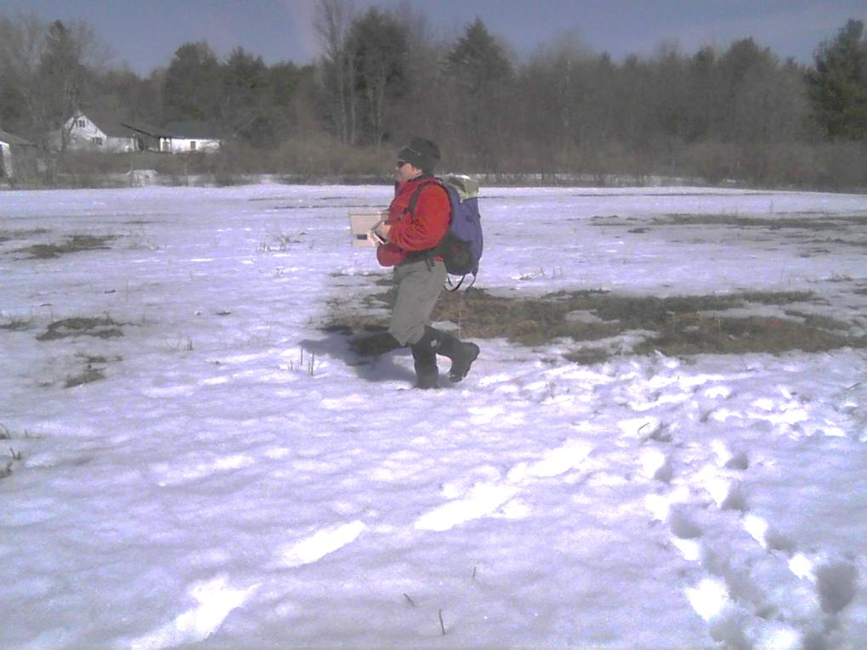
Frost seeded additional Birdsfoot Trefoil seed with broadcast seeder
in early Spring 2015

Slide 9
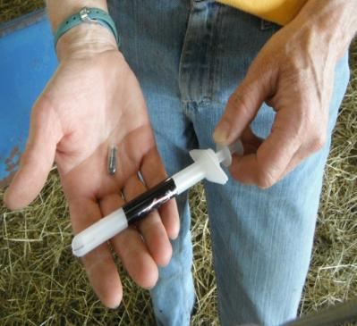
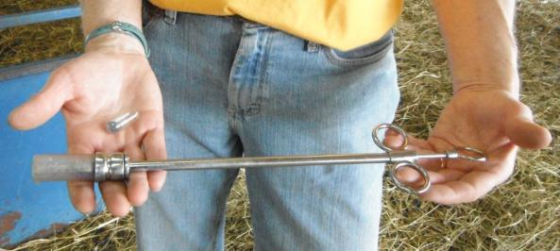
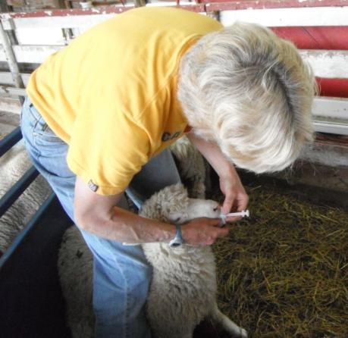
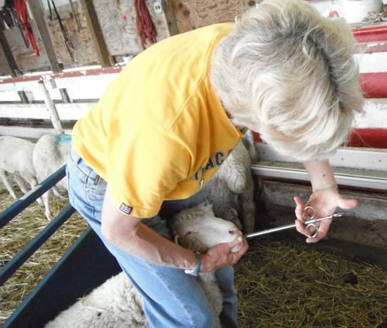
Copper Oxide Wire Particles” given 2 weeks prior to weaning

Slide 10
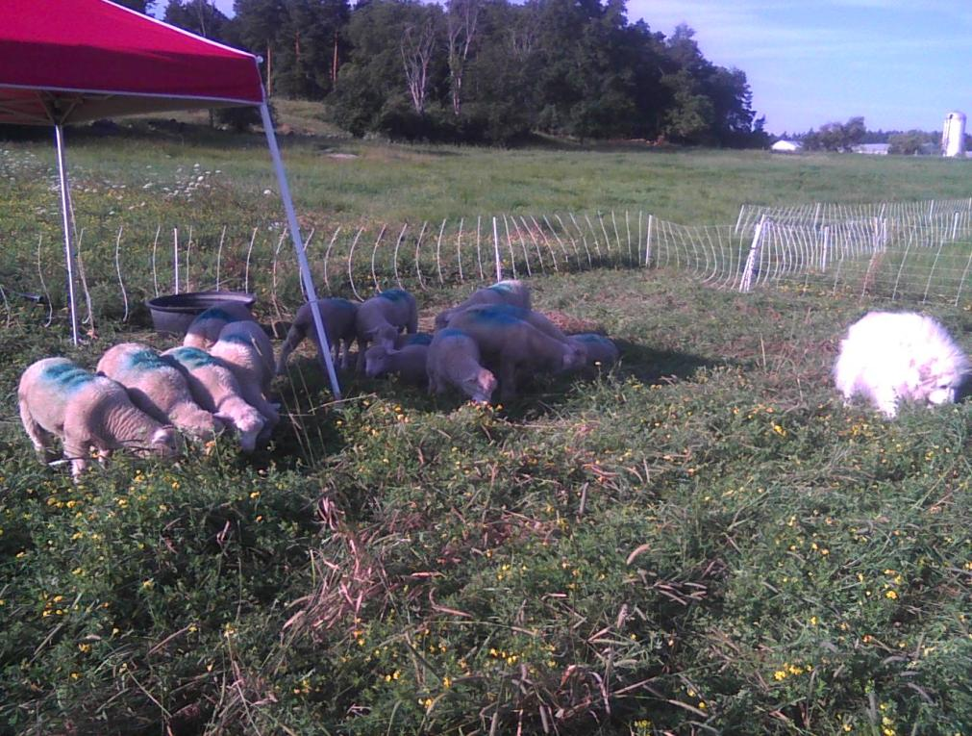
After weaning, 16 lambs grazed on birdsfoot trefoil paddocks
Half of these lambs received 1 gram of copper oxide wire particles (COWP) 2 weeks prior to weaning

Slide 11
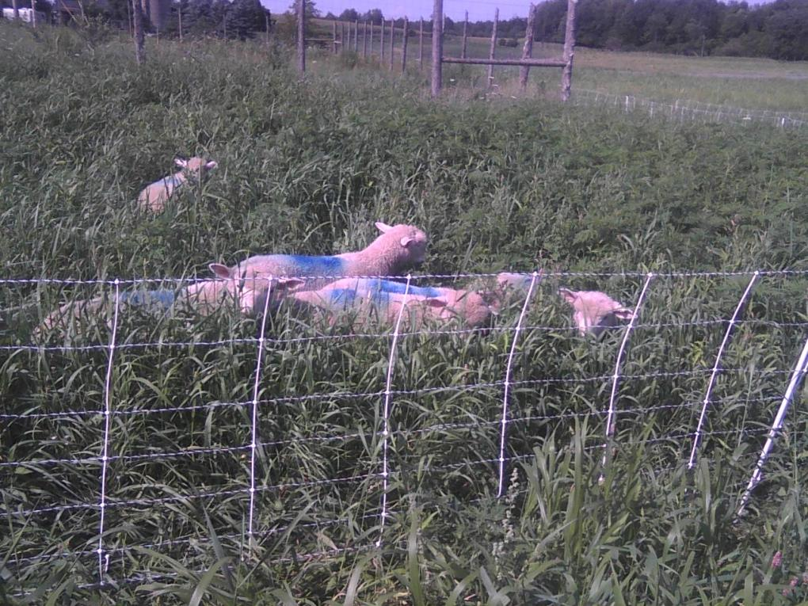
After weaning, 16 lambs grazed on conventional pastures
Half the lambs received 1 gram of COWP 2 weeks prior to weaning

Slide 12
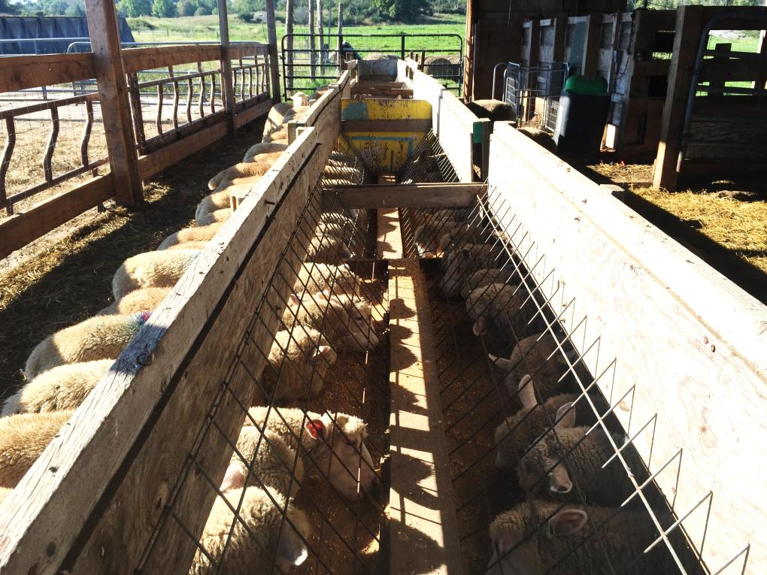
8 lambs were tracked in a Control group fed 2nd cut hay ( 12% CP) and grain (16% CP). Each lamb received 1 gram COWP 2 weeks prior to weaning

Slide 13
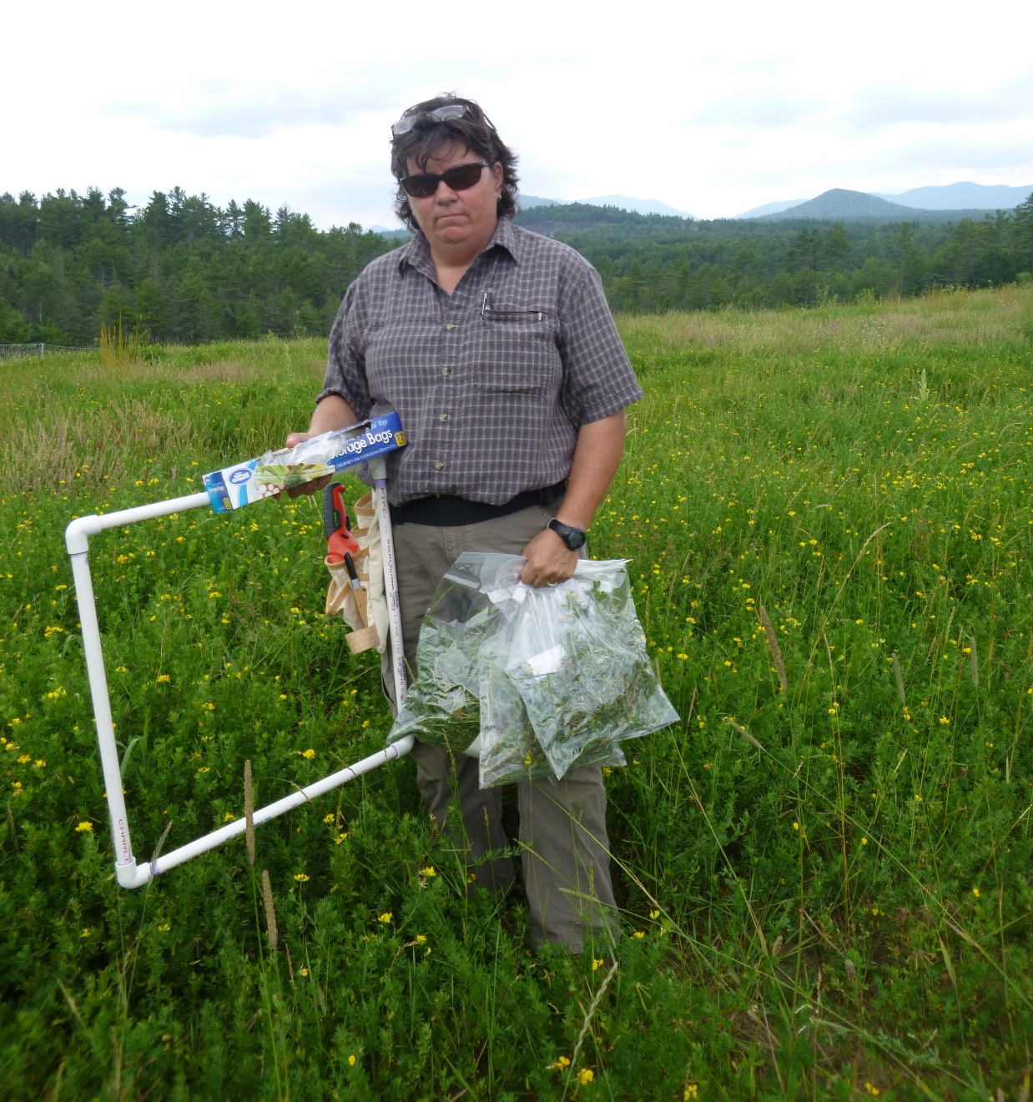

Slide 14
On June 8th, total BFT dry matter in biomass averaged about 27.5%. However, during the grazing trial (`July 25th to Sept 16th ) the percentage of BFT in the biomass dry matter ranged from ~ 42.8% to 57.5%.

Slide 15
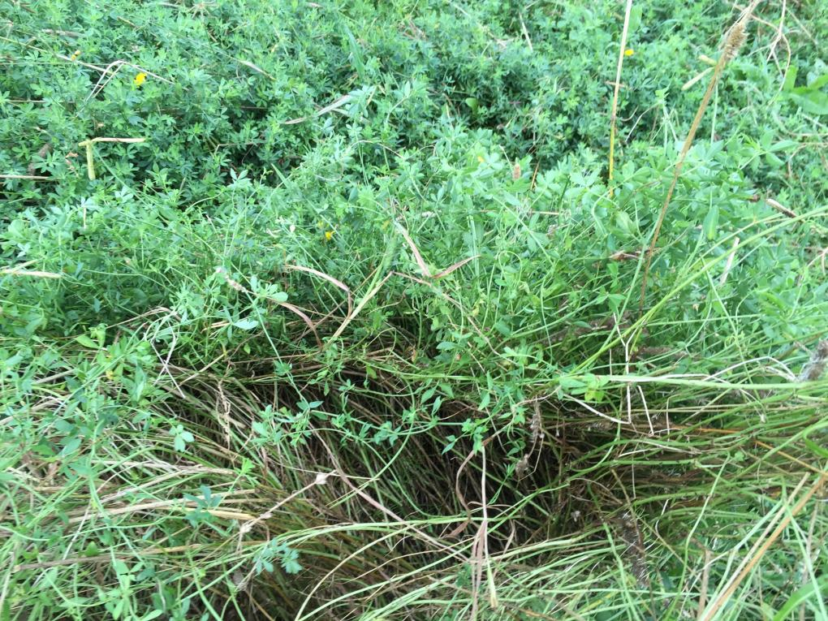
Both the BFT Pasture and Conventional Pasture had not been grazed yet that year and were pretty mature.

Slide 16
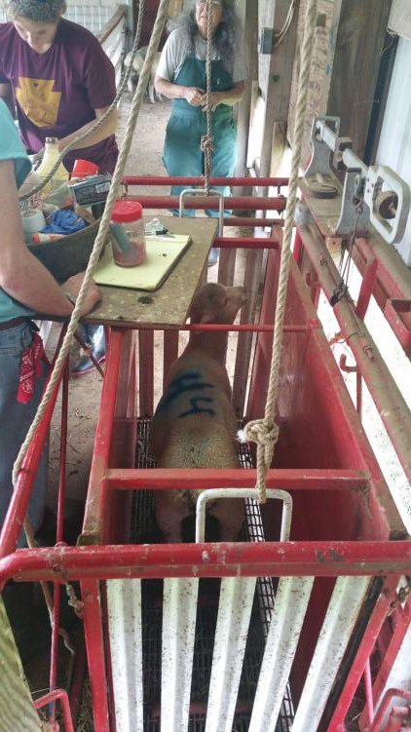
Lambs were weighed
2 weeks pre-weaning (start of the COWP study)
At weaning (start of the grazing trial)
8 wks. post weaning (end of the grazing trial)

Slide 17
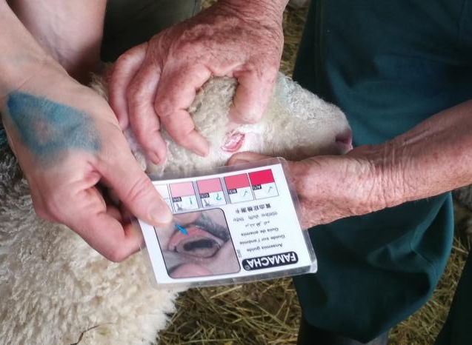
Lambs were FAMACHA scored every 2 wks.
FAMACHA is a method of assessing anemia by comparing the color of the inside of the eyelid to a chart:
Excellent
Good
OK
Anemic
Very anemic

Slide 18
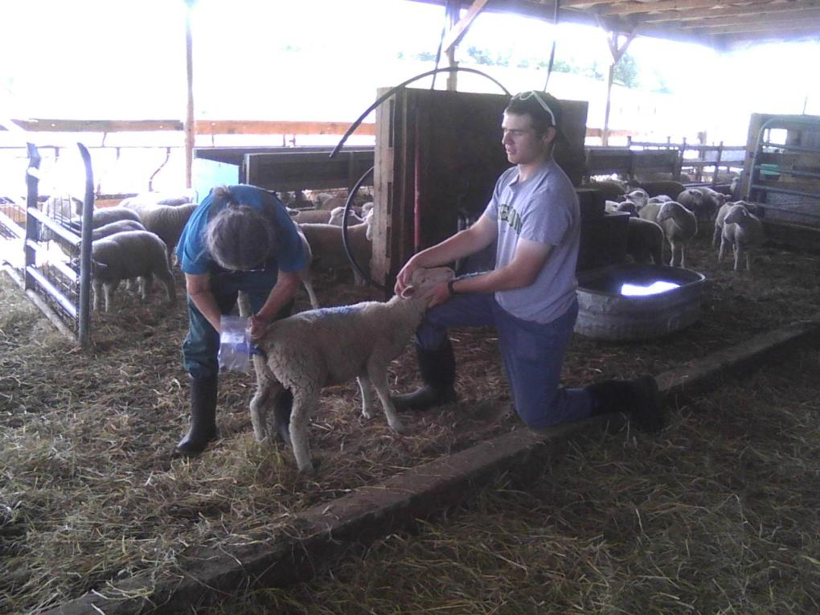
Fecal samples were collected very 2 weeks. Strongyle and Haemonchus (Barber pole worm, a subset of Strongyle) eggs were counted in feces in Bowman lab

Slide 19
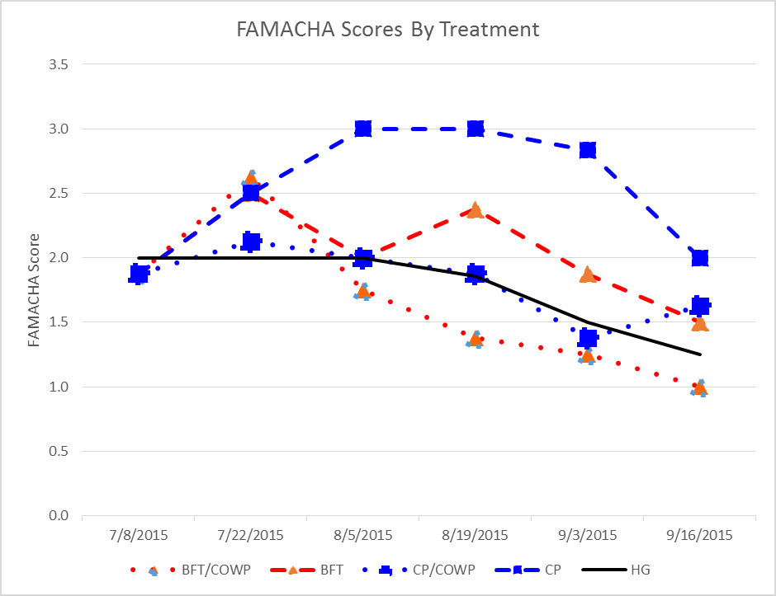
During the grazing trial, the lambs on conventional pasture w/o COWP averaged the highest FAMACHA scores (lower is good) Figure1. FAMACHA Scores by Treatment
4 lambs had to be dewormed and no
longer included
COWP given
Lambs weaned
2 lambs had to be dewormed and no longer included

Slide 20
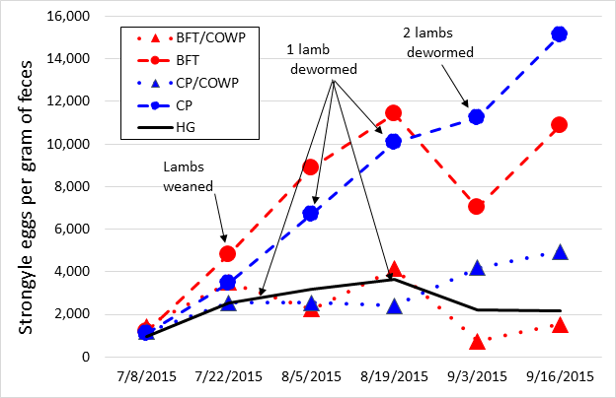
Treatments that got COWP appeared to have lower worm egg counts throughout the study. We were excited by the dip in worm egg counts for the two BFT groups at 6 wks. although it was temporary. Figure 2. Roundworm Egg Count by Treatment

Slide 21
This chart shows that the changes in roundworm egg counts observed in previous slide can be attributed primarily to changes in the barber pole worm egg population

Slide 22
The treatments on BFT appeared to gain weight similarly to the treatment on hay and grain while the treatments on conventional pastures appeared to grow slower

Slide 23
Table 1. Weight Gain by Treatment during 70 d. Grazing Trial
 | Birdsfoot Trefoil + COWP | Birdsfoot Trefoil | Conventional Pasture + COWP | Conventional Pasture (4 lambs dewormed) | Hay & Grain + COWP (2 lambs dewormed)
Date | Weight (lbs.)
7/08/2015 | 46.4 | 49.0 | 45.5 | 43.9 | 46.9
7/22/2015 | 49.0 | 53.3 | 50.9 | 53.3 | 52.5
9/16/2015 | 67.6 | 64.3 | 56.9 | 56.3 | 64.3
Gain (lbs.) | 21.3 | 15.3 | 11.4 | 12.4 | 17.4
Days | 70.0 | 70.0 | 70.0 | 70.0 | 70.0
Daily gain (lbs.) | 0.304 | 0.218 | 0.163 | 0.178 | 0.248

Slide 24
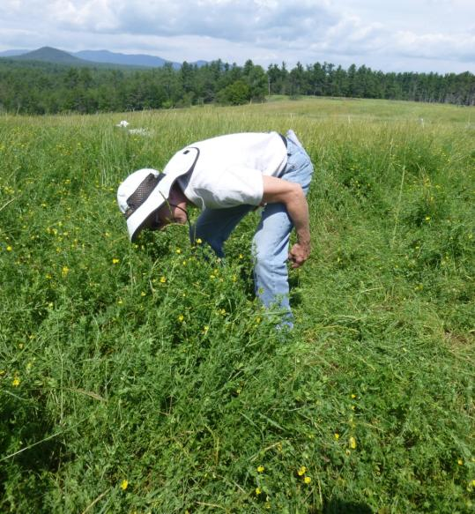
Asgaard Goat Dairy AuSable, NY
Compared
grazing a 3 acre field of Pardee Birdsfoot Trefoil (planted in Spring 2014)
To
grazing a conventional pasture
Soil Type: Adams
Soil pH: 7.2
P: 511 lbs/acre
K: 675 lbs/acre
Ca: 5,494 lbs/acre
Mg: 808 lbs/acre
% OM: 5.2

Slide 25
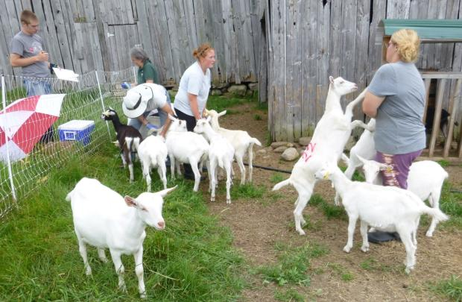
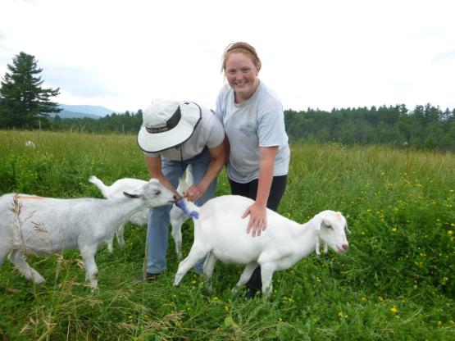
Dairy x Kiko goat kids that had been taken from dairy dams shortly after birth and raised on separate property
Fecal Samples - Sadly (for us), round worm eggs were absent from all fecal samples throughout study!!!
Bulk samples from conv. pasture group (but not BFT group) did grow a few round worm larvae in weeks 6 and 8.

Slide 26
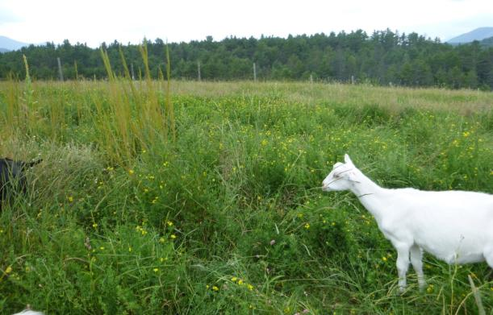
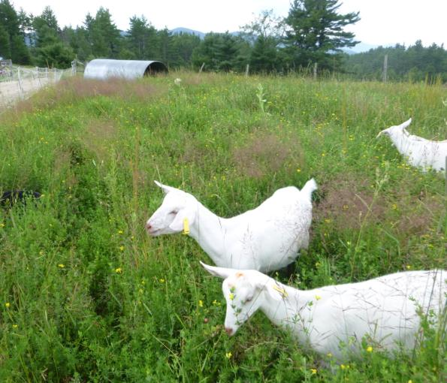
Kids in both treatments also received 1 pound of grain each per day
Unable to weigh at beginning of study.
Weights taken Weeks 2, 4 and 8

Slide 28
In summary
When animals have worm loads, animals on BFT appear to be more resilient
Is this simply due to better nutrition?
Or are there compounds in BFT that boost their immune systems and make them more able to cope?
Grassfed lambs appear to grow well on lush BFT pastures
Does grazing BFT for at least 4 weeks help to control strongyle worms (roundworms)?
Jury is still out
In herds where COWP is effective and barber pole worms are present, dosing with COWP and feeding BFT appear to improve performance (better FAMACHA scores and weight gains) as compared to doing only one of these treatments or neither.

Slide 29
WARNING!!
All results presented today are very preliminary and include only raw means of un-transposed data
We have not double checked our entries and could have made some important typos!
We have no idea yet if there are actually any significant differences between treatments!

Slide 30
Problems encountered growing BFT
Good germination requires excellent soil to seed contact without seed being too deep – very small seed
Most problems centered around competition from other plants
Lodging
Shading and rotting

Slide 31
Research sponsored by
USDA Organic Research & Education Initiative
Northeast Sustainable Agricultural Research & Education Program
Federal Formula Funds
Northern NY Agricultural Development Program: www.nnyagdev.org
With staff from Cornell Sheep & Goat Program, St. Lawrence County CCE, and Cornell’s Dwight Bowman Parasitology Lab

